Slide 1


Slide 2

Major Project-I (01CE0716)
Review 1 (23/08/2025)
online learning platforms
Team ID: 7CE_158
Team Member 1: Anurag Tiwari (92201703100) (7EC3)
Guided By
Internal Guide Name: Prof. Rupesh Kanojiya
Department of Computer Engineering, Faculty of Engineering & Technology

Slide 3
Outline
Introduction
Abstract
Objective
Problem Statement
System Design(Activity Diagram, ER Diagram)
Features
Tools and Technologies used
GUI (Frontend)
Store data in Supabase
Conclusion
References

Slide 4
Introduction
StudyNotion is a fully functional ed-tech platform developed using the MERN stack (MongoDB, Express.js, ReactJS, Node.js). The platform allows users to create, consume, and rate educational content while ensuring a seamless and interactive learning experience for students. It also provides instructors with a global platform to showcase their expertise. Key features include course management, secure user authentication, media handling, and a rating system for feedback and engagement.

Slide 5
Abstract
StudyNotion is a comprehensive ed-tech platform designed to enhance learning and teaching experiences for both students and instructors. The platform supports secure user authentication and profile management, course creation, consumption, and rating, as well as cloud-based media management using Cloudinary for videos, images, and documents. The frontend is developed with ReactJS, Tailwind CSS, and Redux, while the backend leverages Node.js, Express.js, and MongoDB. With a strong focus on scalability, security, and user engagement, StudyNotion delivers an efficient and interactive environment for online education..

Slide 6
Objective
Develop a Cross-Platform Ed-Tech Platform: Build a fully functional education platform using the MERN stack (MongoDB, Express.js, ReactJS, Node.js).
Enable Core Learning Features: Allow students to create accounts, browse courses, enroll, consume content, and provide ratings, while instructors can create and manage courses.
Implement Secure Authentication & Authorization: Provide safe access through user authentication and role-based authorization for students and instructors..
Integrate Payment System: Use Razorpay to enable seamless and secure course purchases.
Provide Responsive UI & State Management: Deliver a clean, user-friendly interface with smooth navigation, built using ReactJS, Tailwind CSS, and Redux.
Ensure Scalability & Modular Design: Develop with reusable components, structured APIs, and modular code to support future enhancements.
Deliver Engaging User Experience (UX): Focus on interactivity, accessibility, and performance to create a dynamic and effective online learning environment.

Slide 7
Problem Statement
The growing demand for effective and engaging online learning platforms highlights the limitations of many existing ed-tech solutions, which often face challenges such as limited interactivity, scalability issues, and inconsistent user experiences across devices. There is a need for a modern, scalable solution that supports real-time course interactions, secure authentication, and seamless media handling while providing a consistent user experience. This project, StudyNotion, aims to address these challenges by developing a cross-platform ed-tech platform using the MERN stack, offering features such as course creation, consumption, and rating, along with secure payments, cloud-based media management, and a responsive user-friendly interface to deliver an interactive and reliable learning environment for both students and instructors.

Slide 8
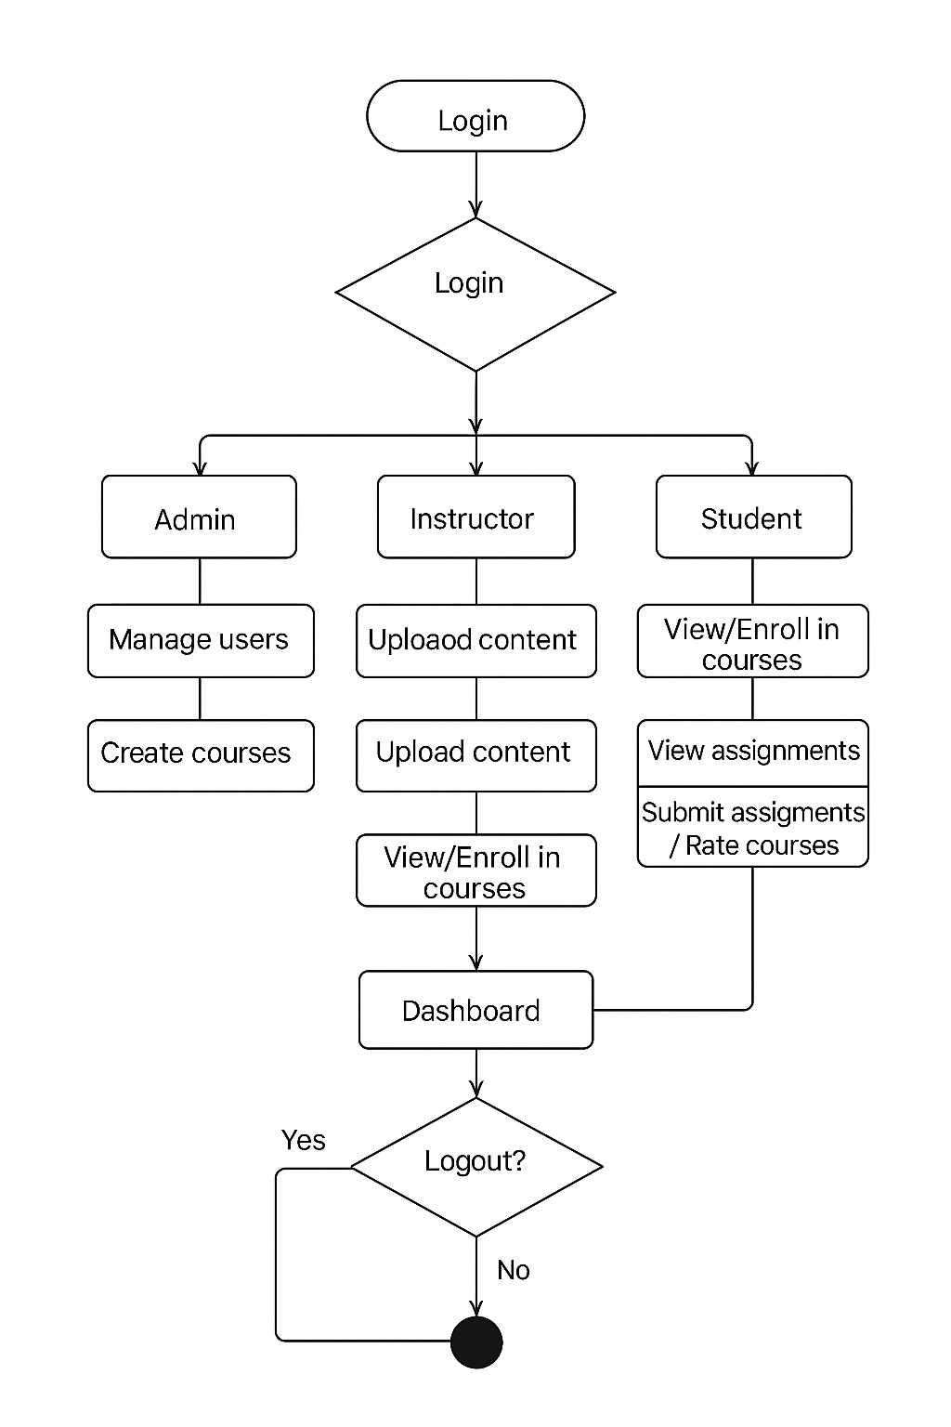
Activity Diagram
Fig :- 1.1

Slide 9
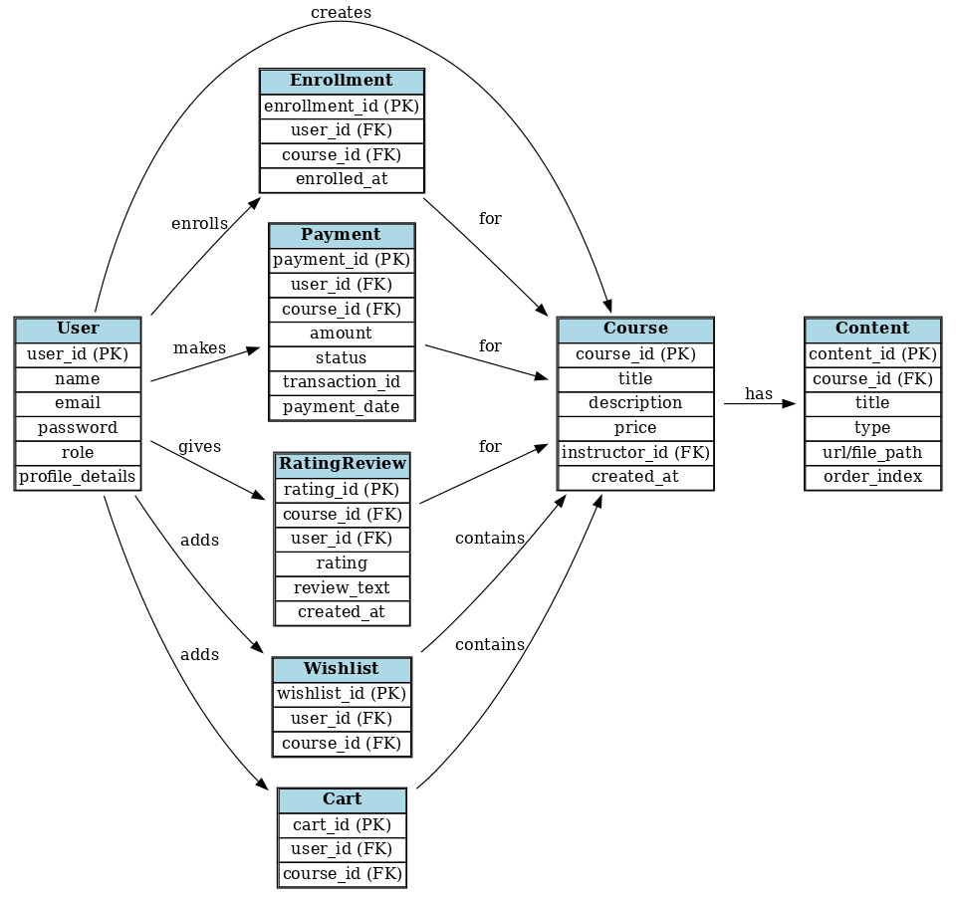
ER-Diaagram
Fig :- 1.1

Slide 10
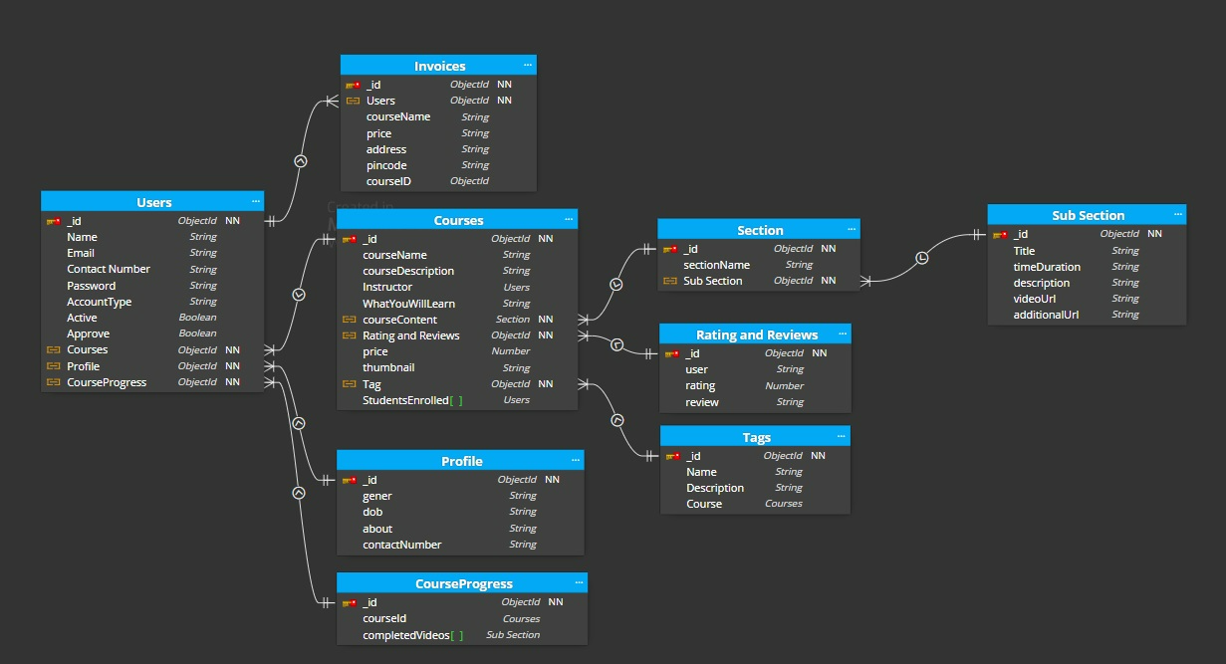
ER-Diagram
Fig :- 1.2

Slide 11
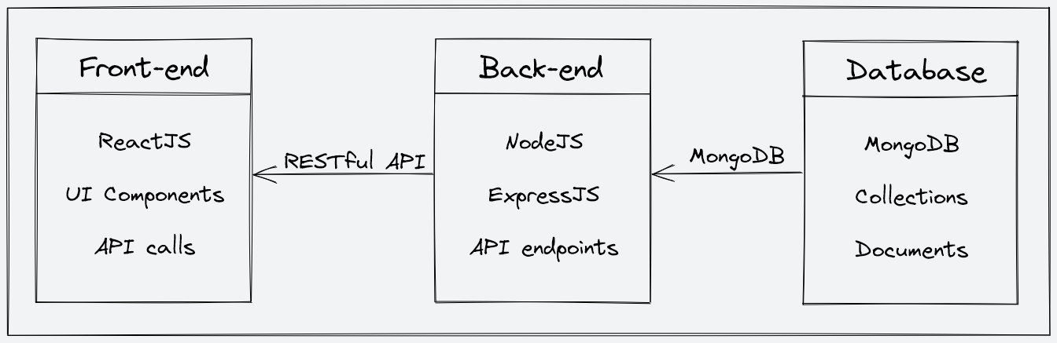
ER-Diagram

Slide 12
ER-Diaagram
Sample list of API endpoints and their functionalities:
The StudyNotion platform's API is designed following the REST architectural style. The API is implemented using Node.js and Express.js. It uses JSON for data exchange and follows standard HTTP request methods such as GET, POST, PUT, and DELETE.
Sample list of API endpoints and their functionalities:
/api/auth/signup (POST) - Create a new user (student or instructor) account.
/api/auth/login (POST) – Log in using existing credentials and generate a JWT token.
/api/auth/verify-otp (POST) - Verify the OTP sent to the user's registered email.
/api/auth/forgot-password (POST) - Send an email with a password reset link to the registered email.
/api/courses (GET) - Get a list of all available courses.
/api/courses/:id (GET) - Get details of a specific course by ID.
/api/courses (POST) - Create a new course.
/api/courses/:id (PUT) - Update an existing course by ID.
/api/courses/:id (DELETE) - Delete a course by ID.
/api/courses/:id/rate (POST) - Add a rating (out of 5) to a course.

Slide 13
ER-Diaagram
Sample API requests and responses:
GET /api/courses: Get all courses
Response: A list of all courses in the database
GET /api/courses/:id: Get a single course by ID
Response: The course with the specified ID
POST /api/courses: Create a new course
Request: The course details in the request body
Response: The newly created course
PUT /api/courses/:id: Update an existing course by ID
Request: The updated course details in the request body
Response: The updated course
DELETE /api/courses/:id: Delete a course by ID
Response: A success message indicating that the course has been deleted.
/api/courses/:id/rate (POST) - Add a rating (out of 5) to a course.

Slide 14
Features
User Authentication: Secure signup/login with JWT, OTP, and password reset.
User Profiles: Editable student/instructor profiles with role-based dashboards.
Course Management: Create, update, delete, browse, and rate courses.
Media Handling: Cloud-based storage with Cloudinary for videos, images, and documents.
Payment Integration: Razorpay-enabled checkout for course purchases.
Learning Experience: Video lectures, markdown notes, assignments, quizzes, and certificates.
Instructor Tools: Course analytics, student progress tracking, and content management.
Admin Controls: Platform insights, user management, and instructor/course moderation.
Notifications: Real-time updates for enrollments, assignments, and announcements.
Scalability & Security: MERN stack architecture with JWT, bcrypt
Mentorship Module: Juniors connect with seniors (platform alumni) for doubt resolution, guidance, and personalized learning roadmaps.(Future Scope)

Slide 15
Tools and Technologies used
Front-End Technologies
Framework: ReactJS for dynamic and responsive interfaces
ReactJS: Used as the core library for building dynamic, component-based, and responsive user interfaces.
Redux Toolkit: Implemented for efficient state management and predictable application flow.
React Router: Integrated for seamless client-side routing and navigation between pages.
Tailwind CSS: Utilized for responsive and modern styling with utility-first classes.
Framer Motion: Added for smooth animations and interactive transitions, enhancing the user experience.
npm Packages: Various open-source libraries are used to extend functionality and speed up development.

Slide 16
Tools and Technologies used
Back-End Technologies
Framework : Node.js with Express.js is used to develop scalable and efficient server-side logic, enabling RESTful API design and smooth communication with the front end.
Database: MongoDB (NoSQL) provides flexible, schema-less data storage for user accounts, course content, and media resources..
Data Models:
Student : Fields include name, email, password, and enrolled course details.
Student : Fields include name, email, password, and enrolled course details.
Course : Fields include course name, description, instructor reference, and associated media.
Tools & Libraries : Mongoose (ODM for MongoDB), JWT (secure authentication), and Bcrypt (password encryption).

Slide 17
Tools and Technologies used
Media Handling
Cloudinary: Cloud-based storage and management for images, videos, and documents.
Sharp / Expo-Image-Manipulator : Image compression & optimization.
Other Development Tools
VS Code – Code editor
Postman – API testing
ESLint + Prettier – Code linting & formatting
Additional Tools
Razorpay SDK – Payment gateway integration.
Redux Toolkit – State management.
Framer Motion – Animations & transitions.
Tailwind CSS – Utility-first responsive styling.
npm / yarn – Dependency management.
Testing & Debugging
Expo Go / Expo Dev Tools – Live testing on devices
React Native Debugger – Debugging React Native apps
Flipper – Debugging network, logs, and performance
Jest + React Native Testing Library – Unit/UI testing

Slide 18
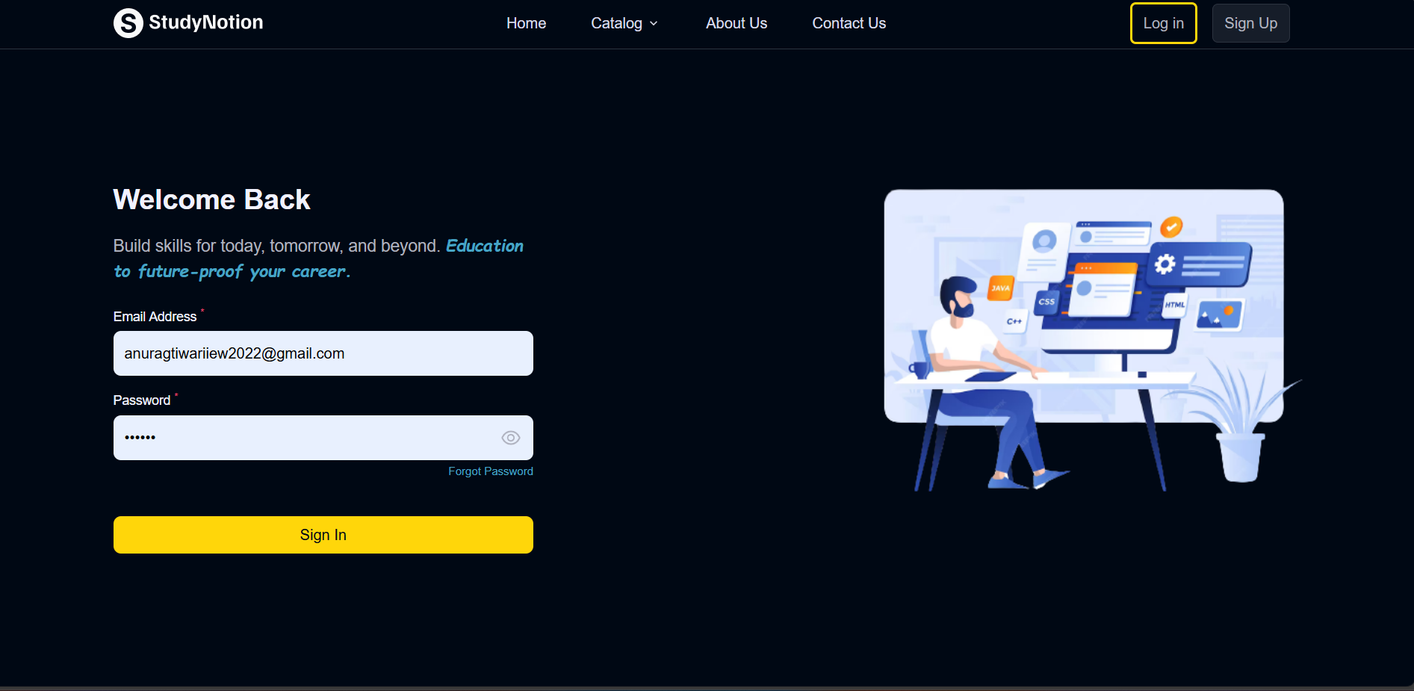
GUI Screenshots

Slide 19
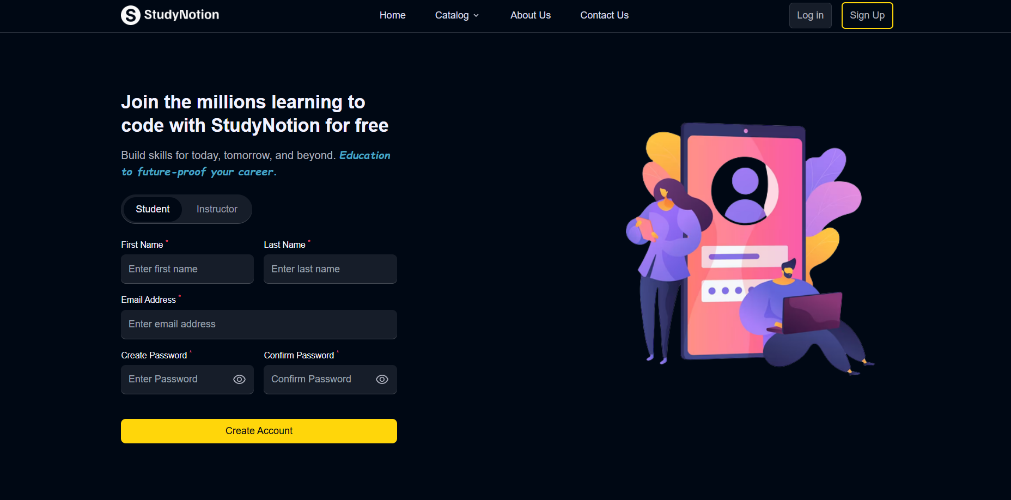
GUI Screenshots

Slide 20
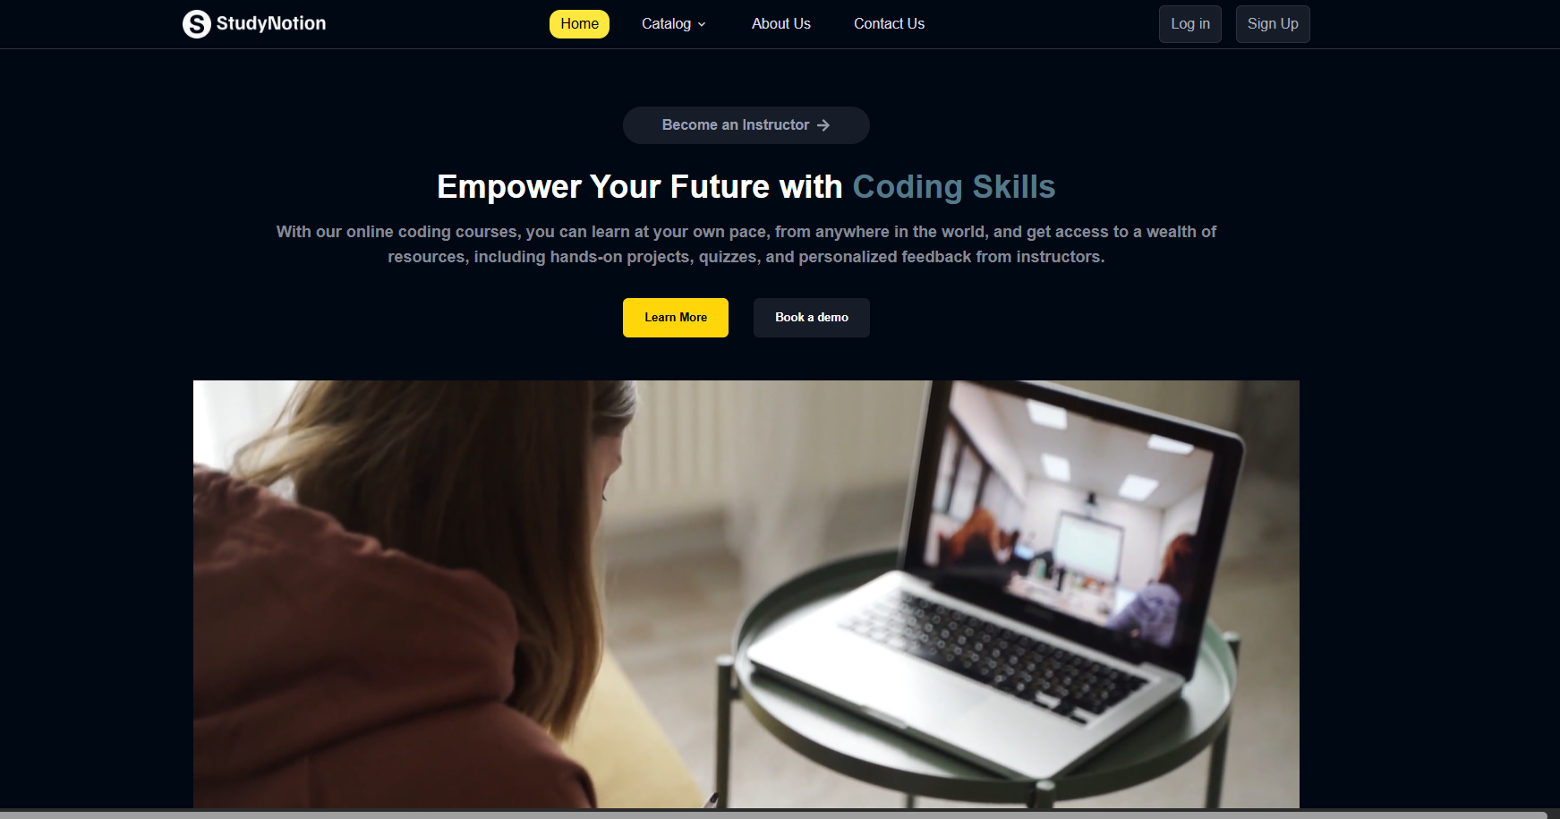
GUI Screenshots

Slide 21
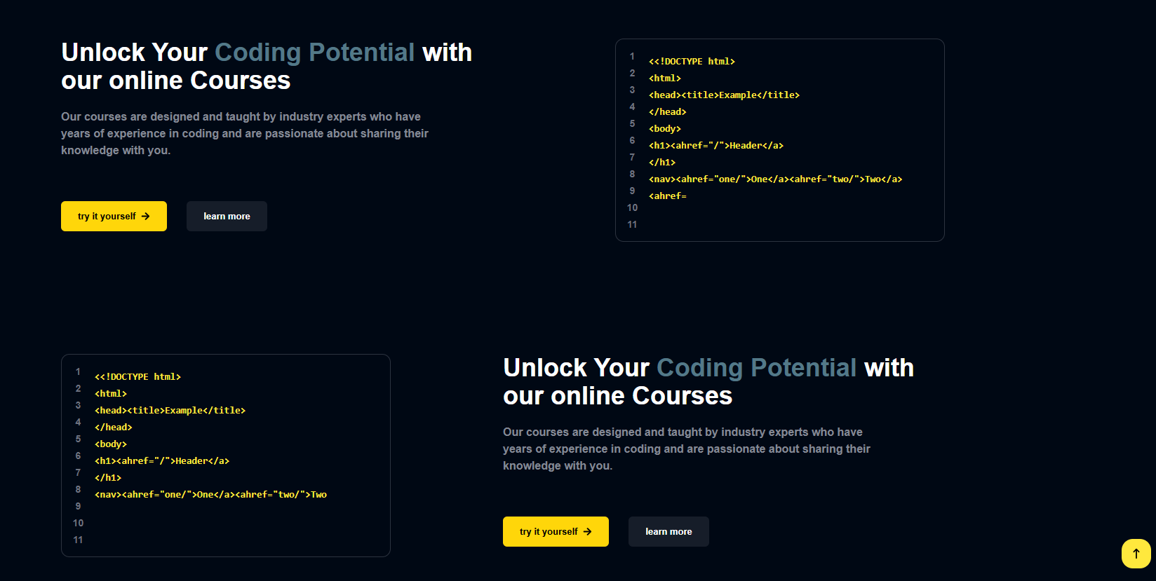
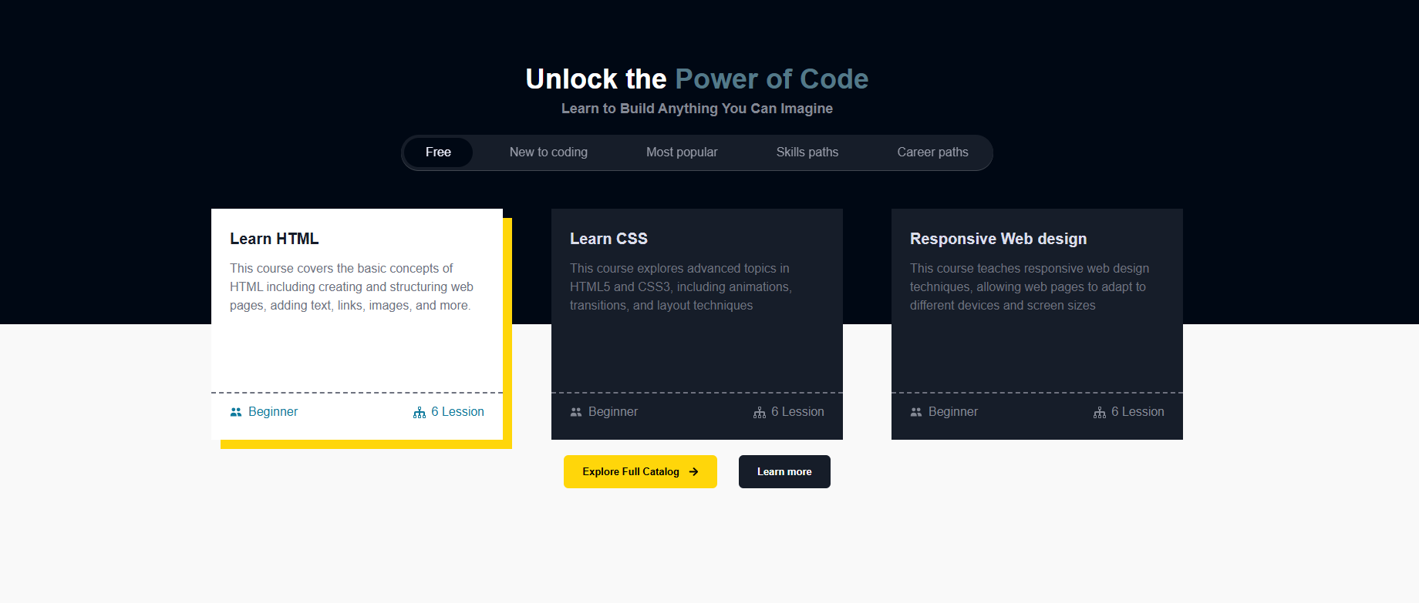
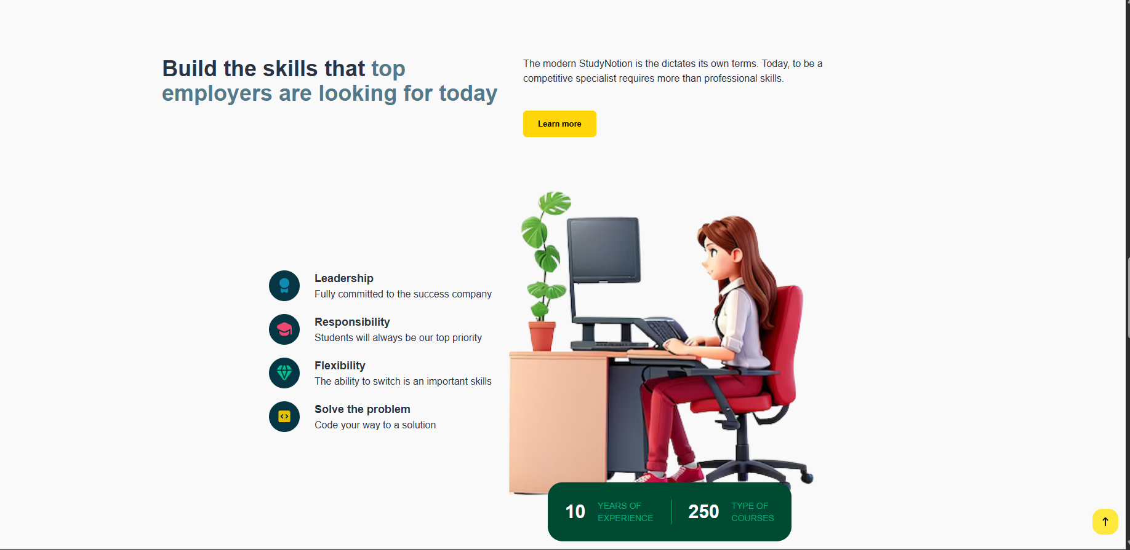
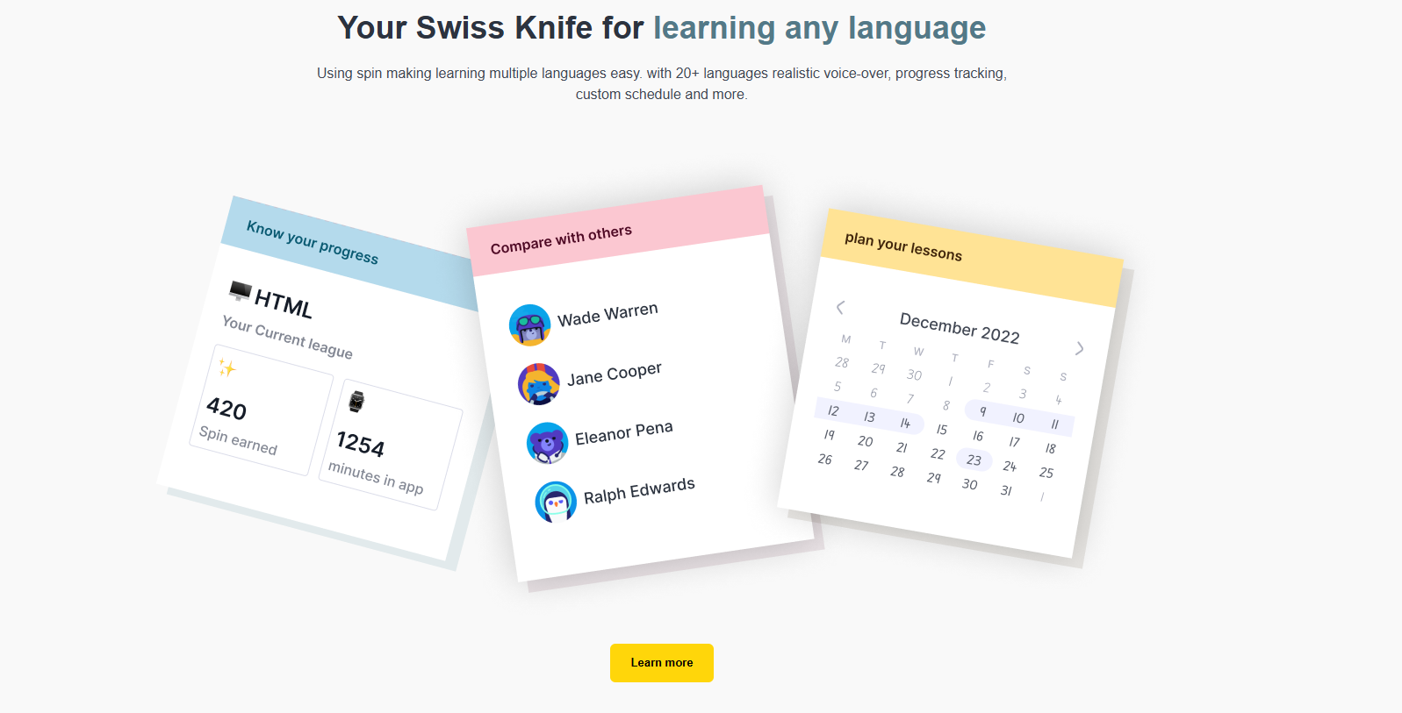
GUI Screenshots

Slide 22
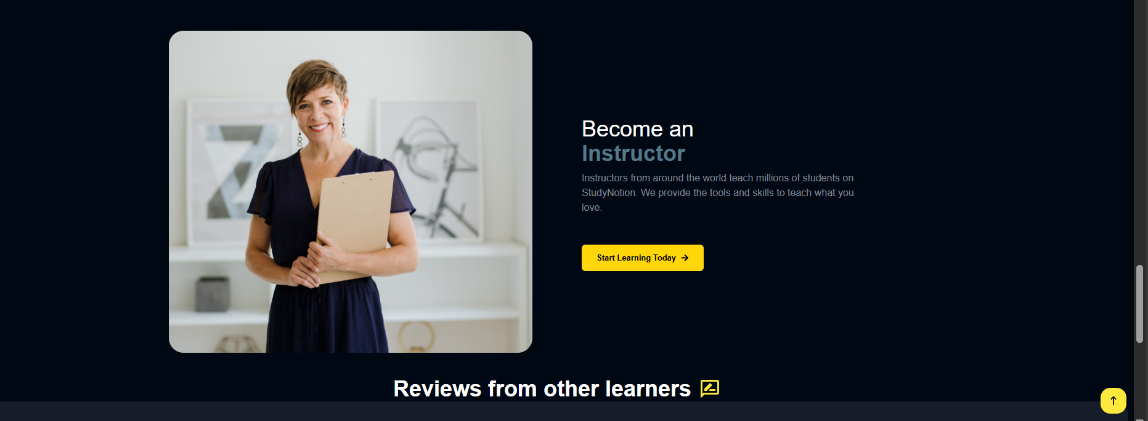
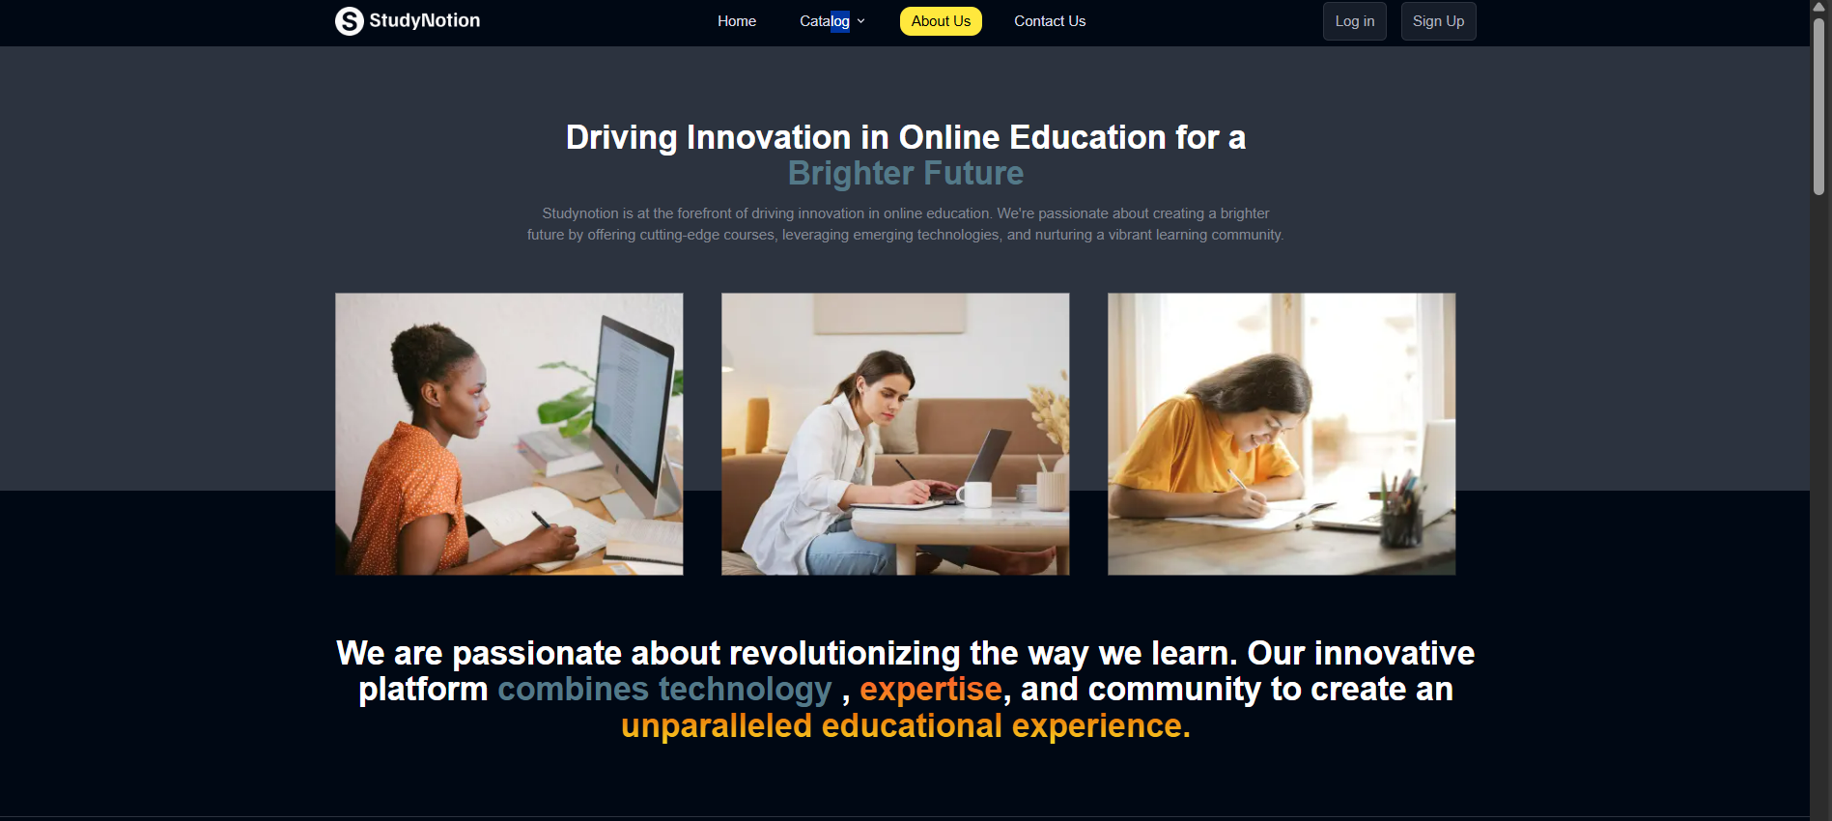
Home Page

Slide 23
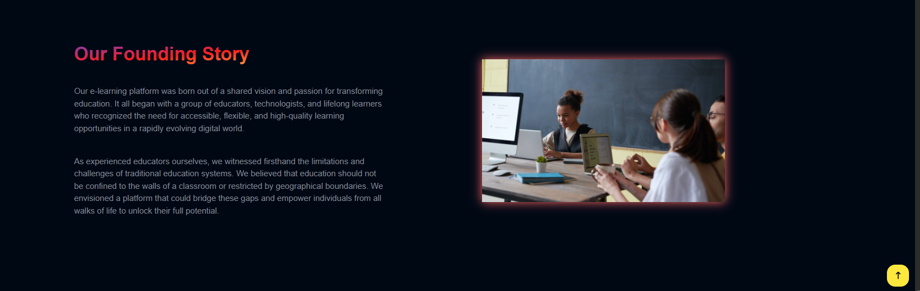
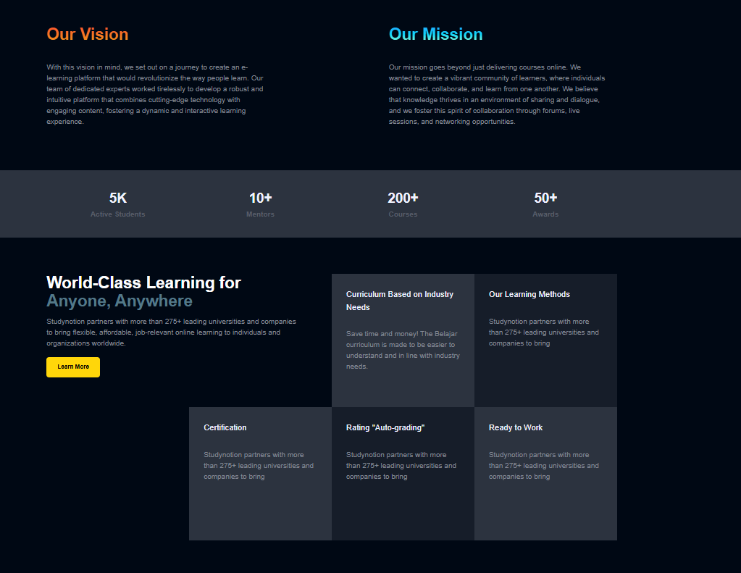
GUI Screenshots

Slide 24
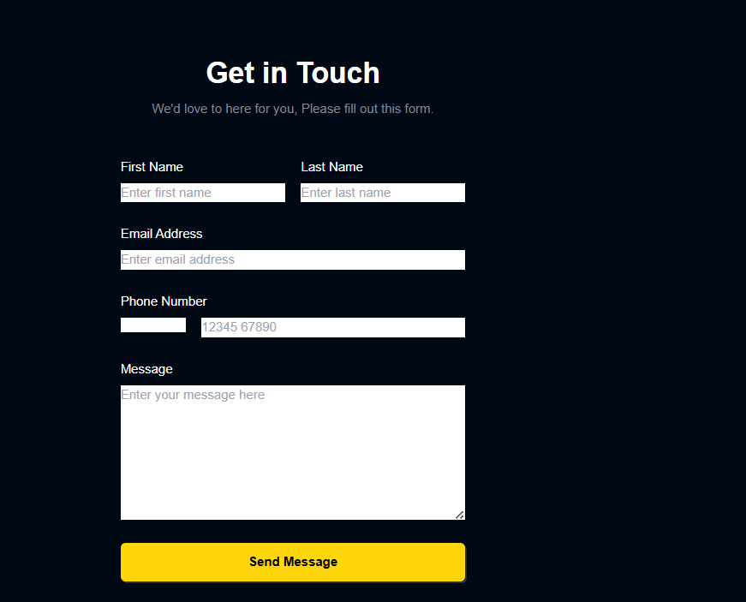
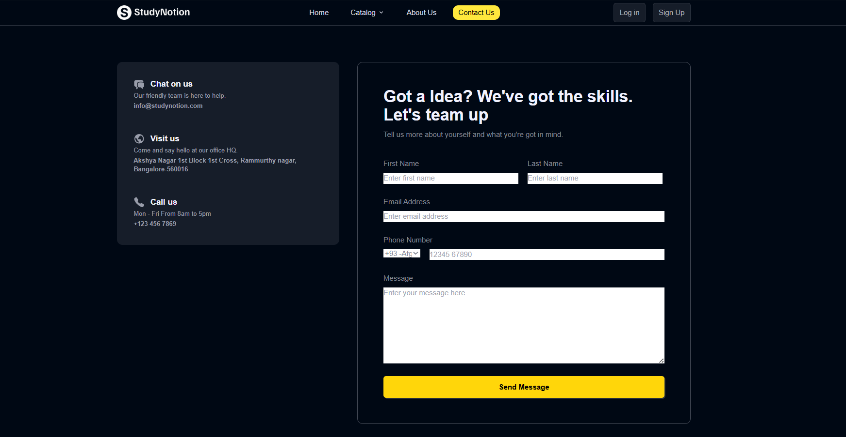
GUI Screenshots

Slide 25
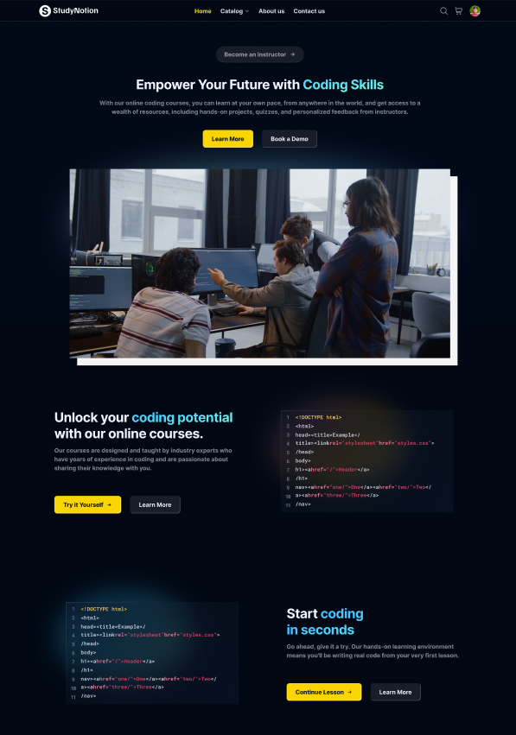
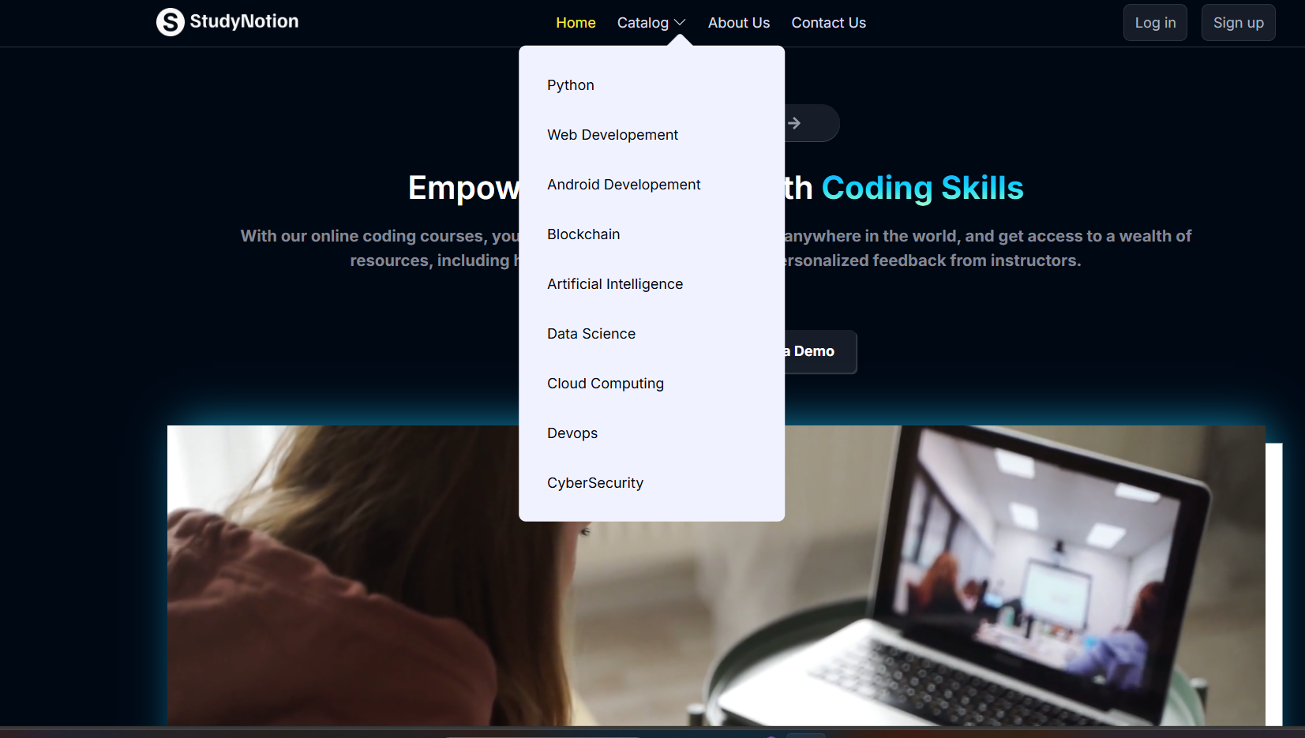
GUI Screenshots

Slide 26
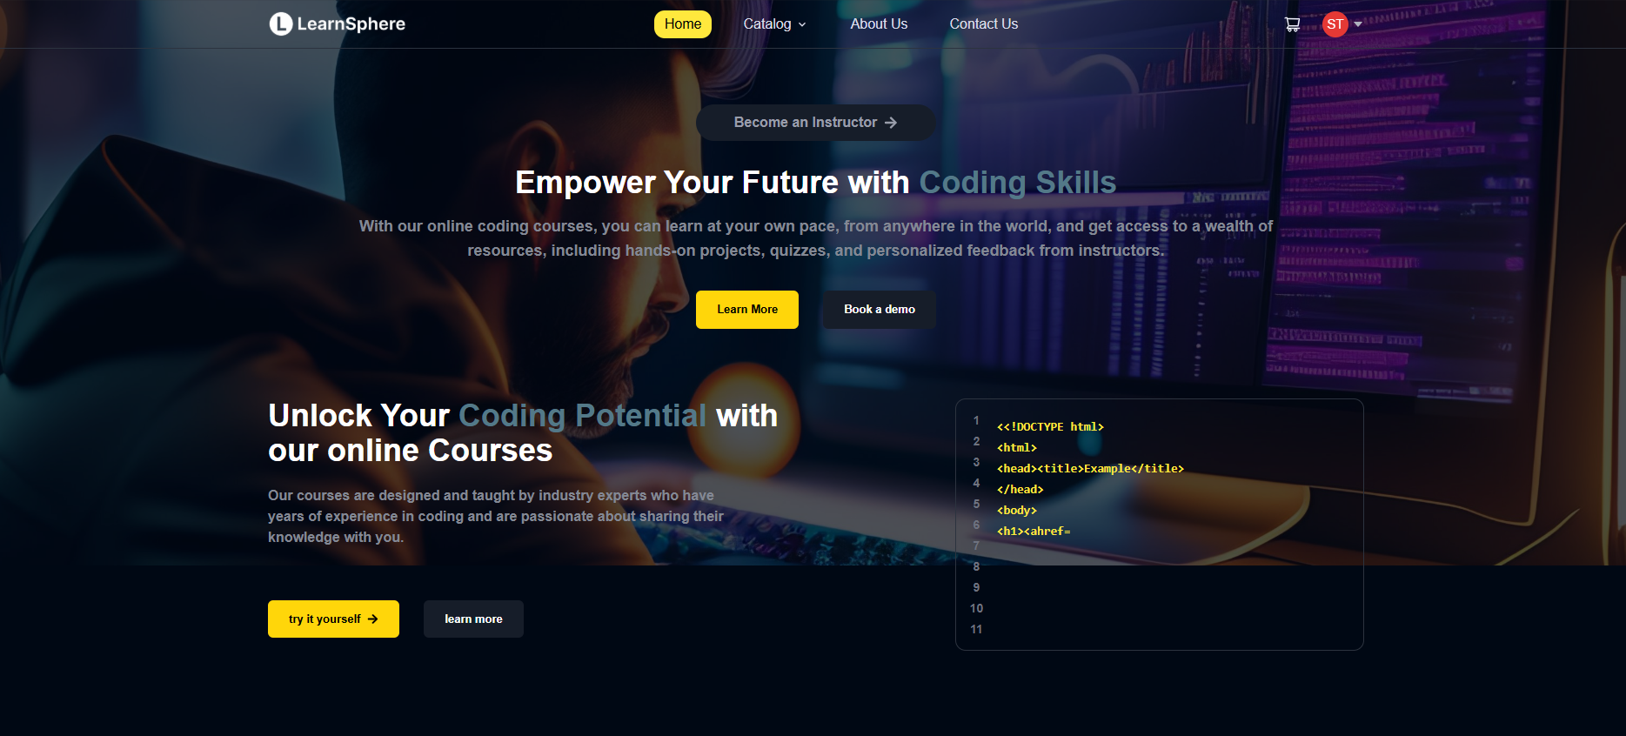
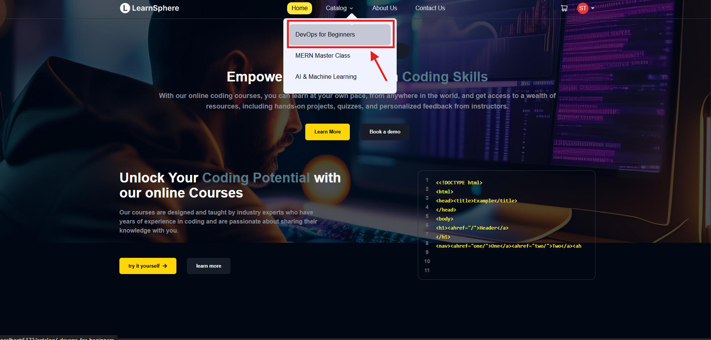
GUI Screenshots

Slide 27
GUI Screenshots

Slide 28
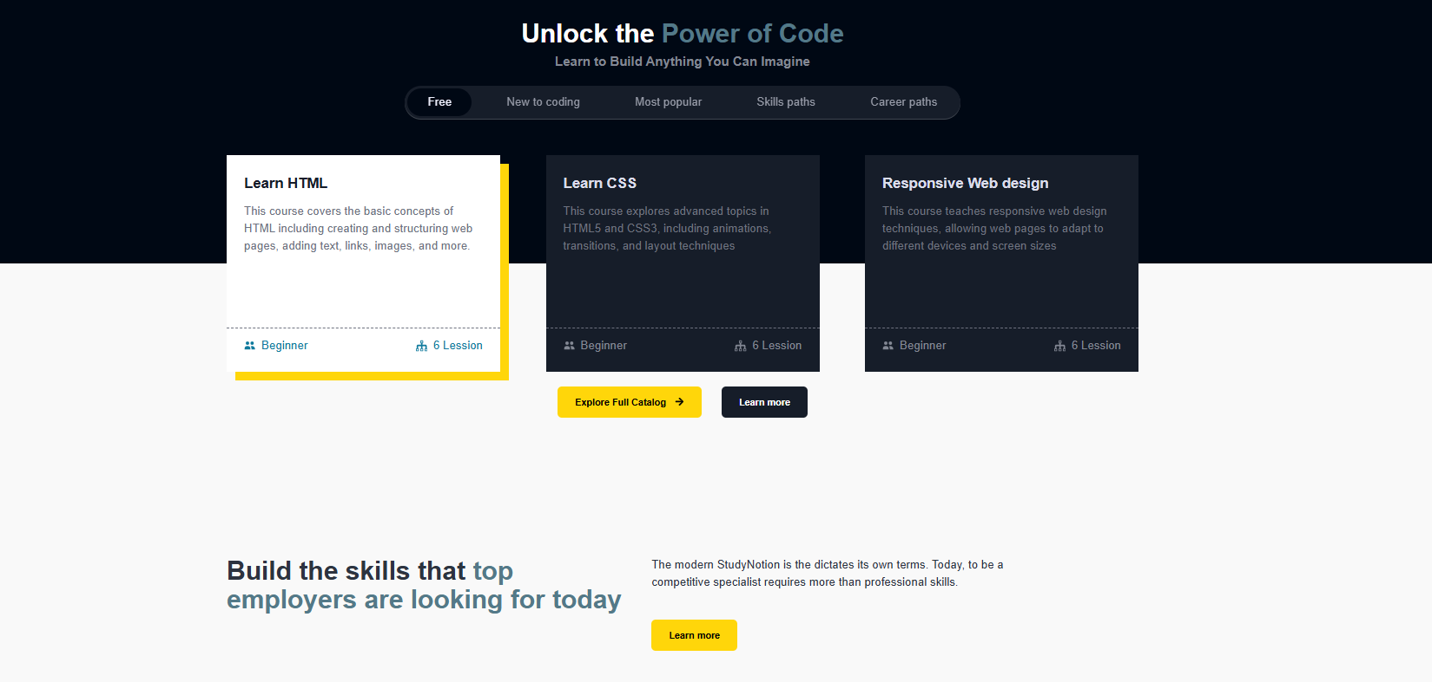
GUI Screenshots

Slide 29
GUI Screenshots

Slide 30
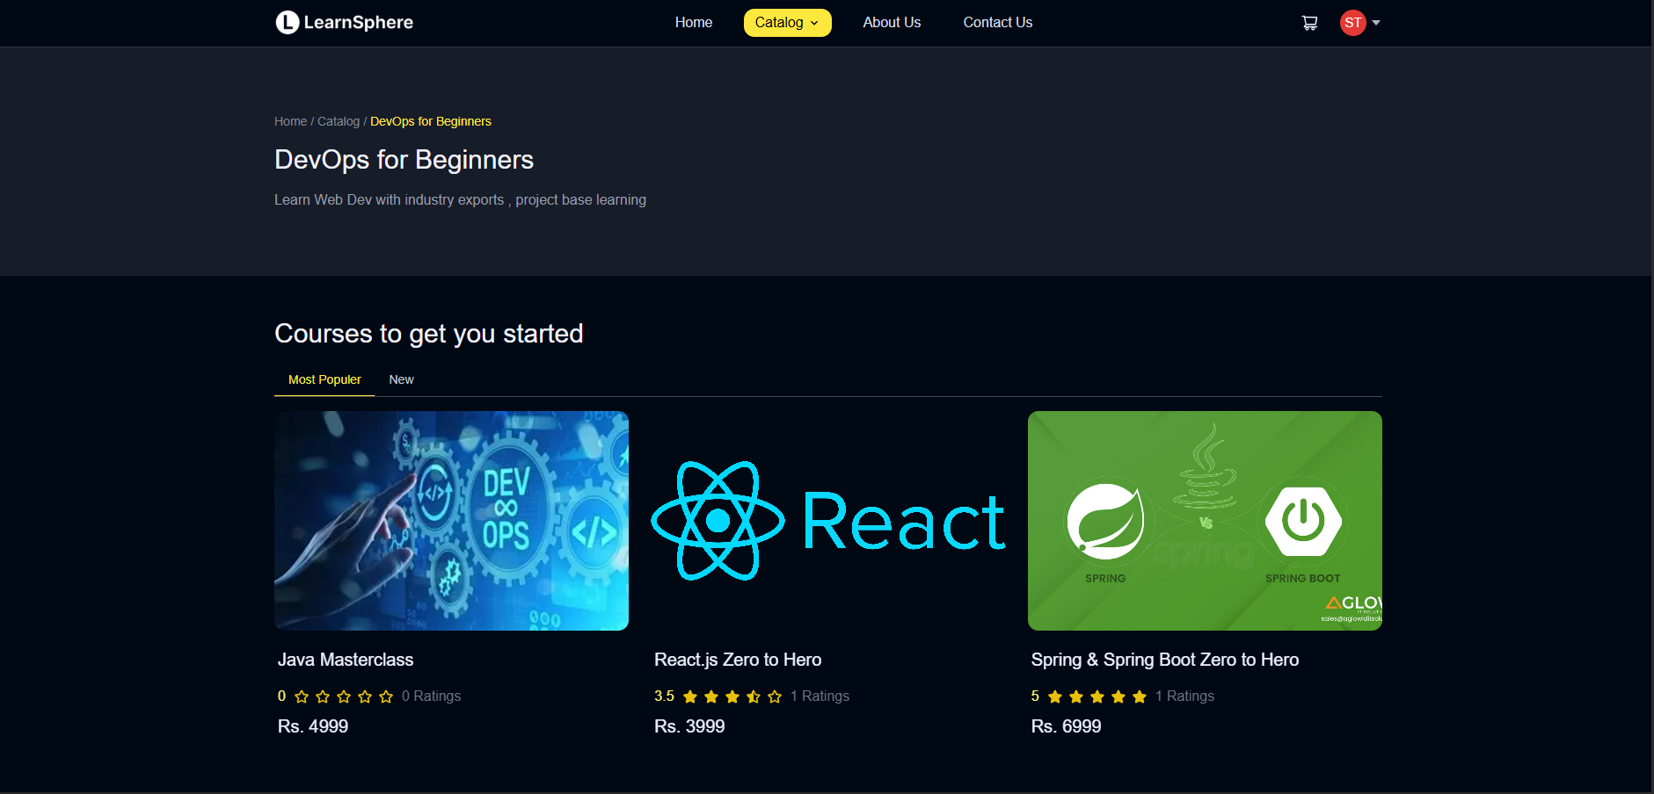
GUI Screenshots

Slide 31
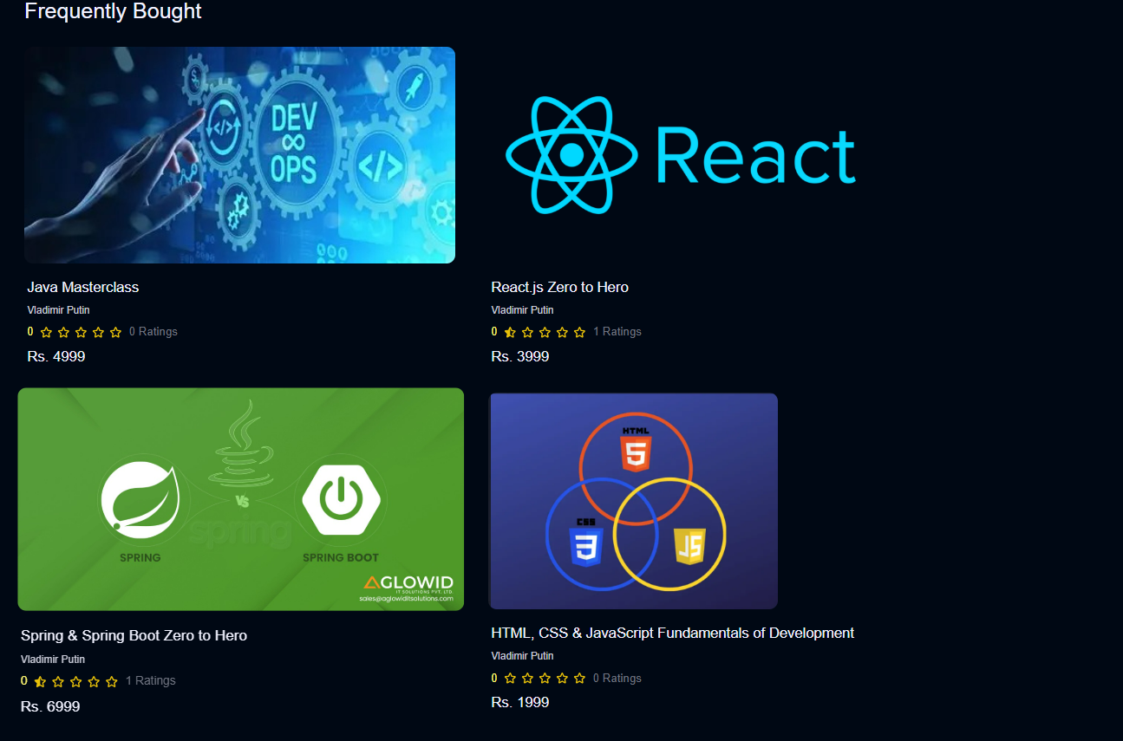
GUI Screenshots

Slide 32
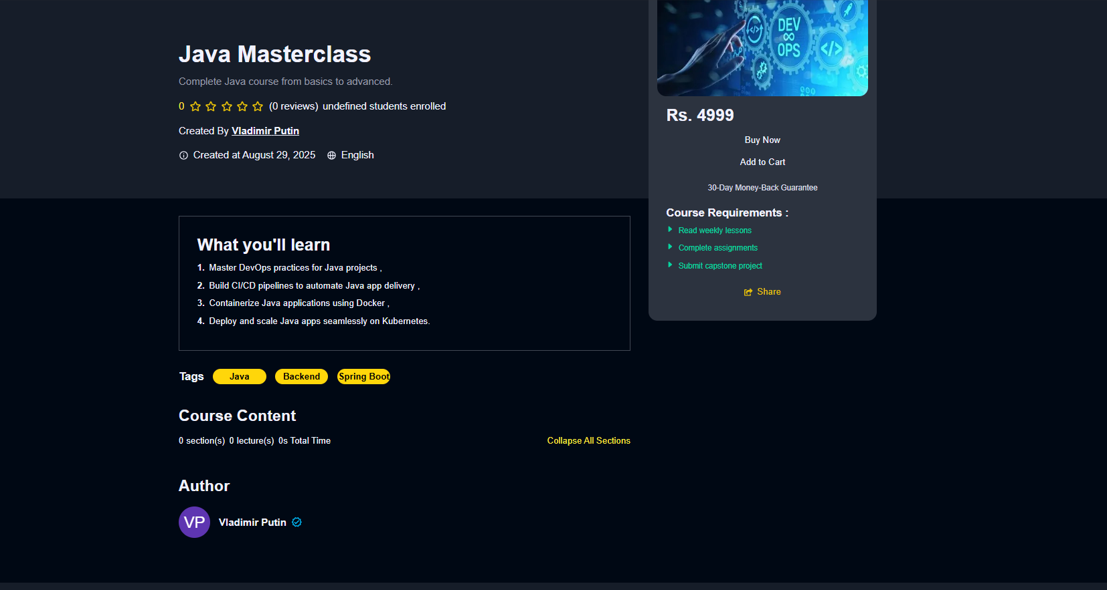
GUI Screenshots

Slide 33
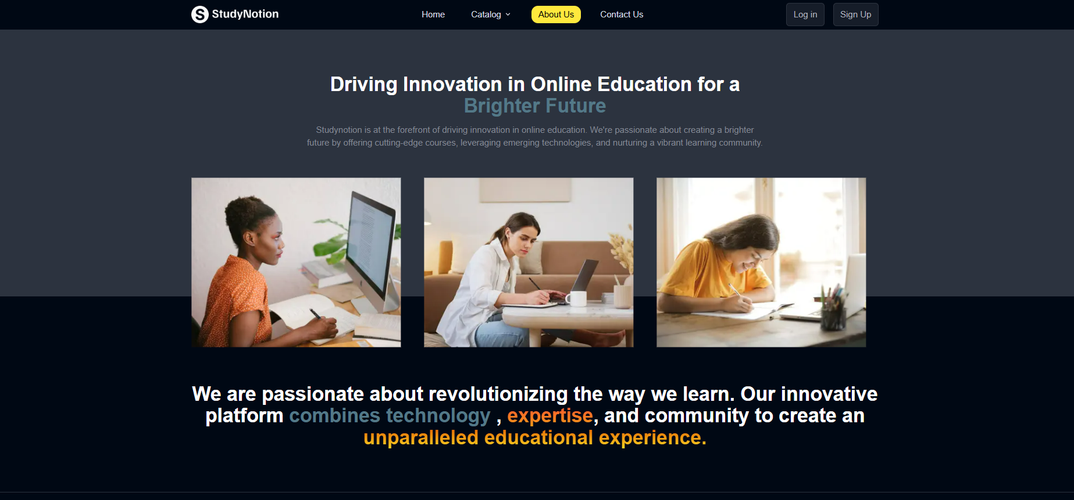
GUI Screenshots

Slide 34
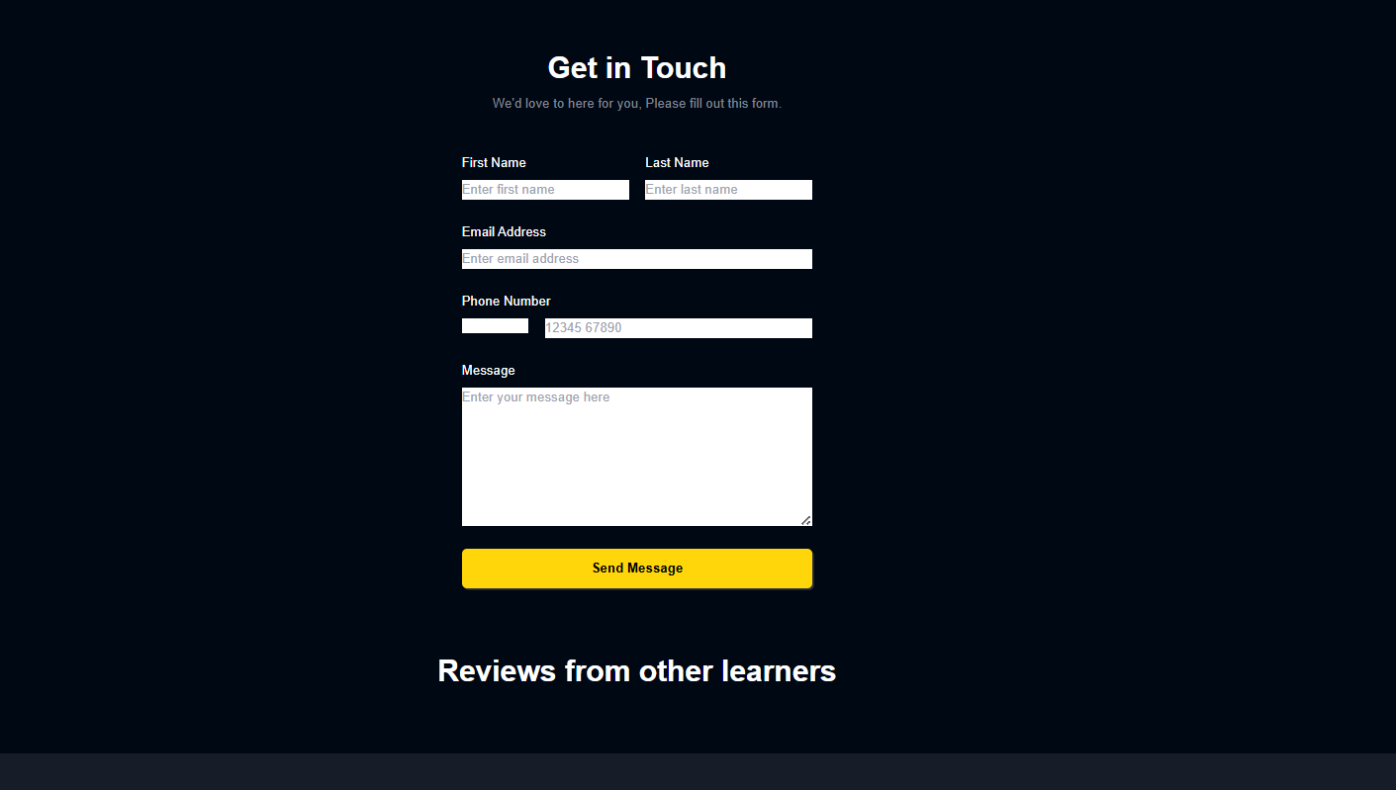
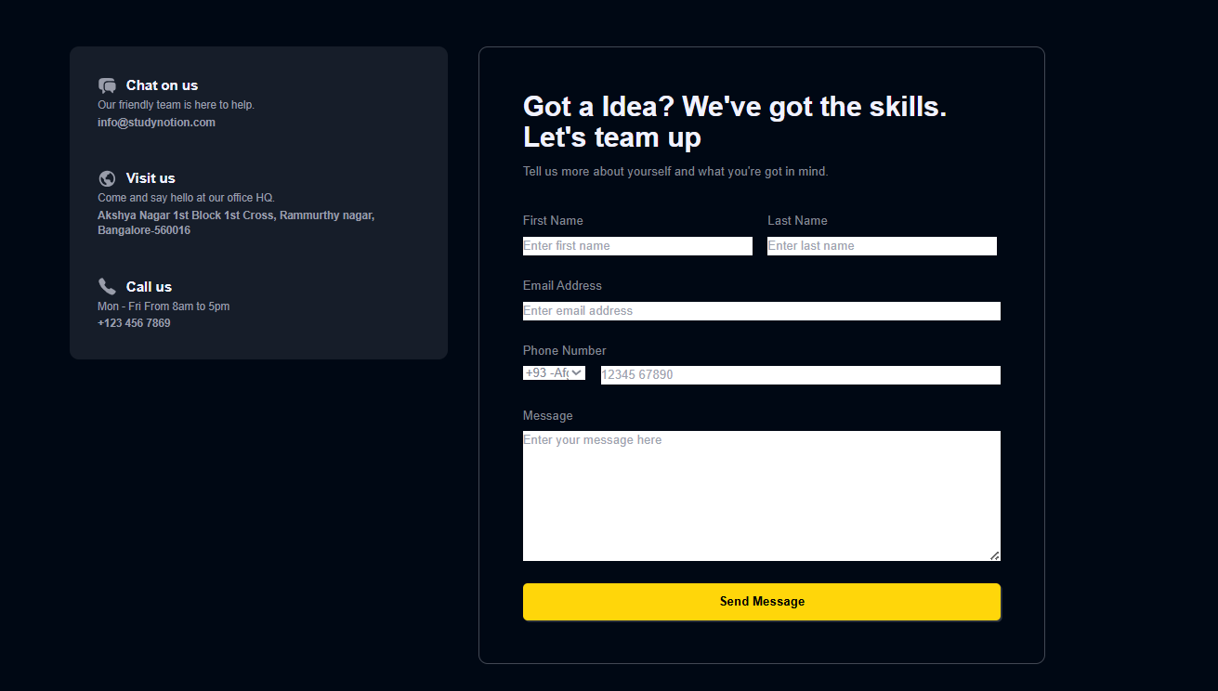
GUI Screenshots

Slide 35

GUI Screenshots

Slide 36

GUI Screenshots

Slide 37
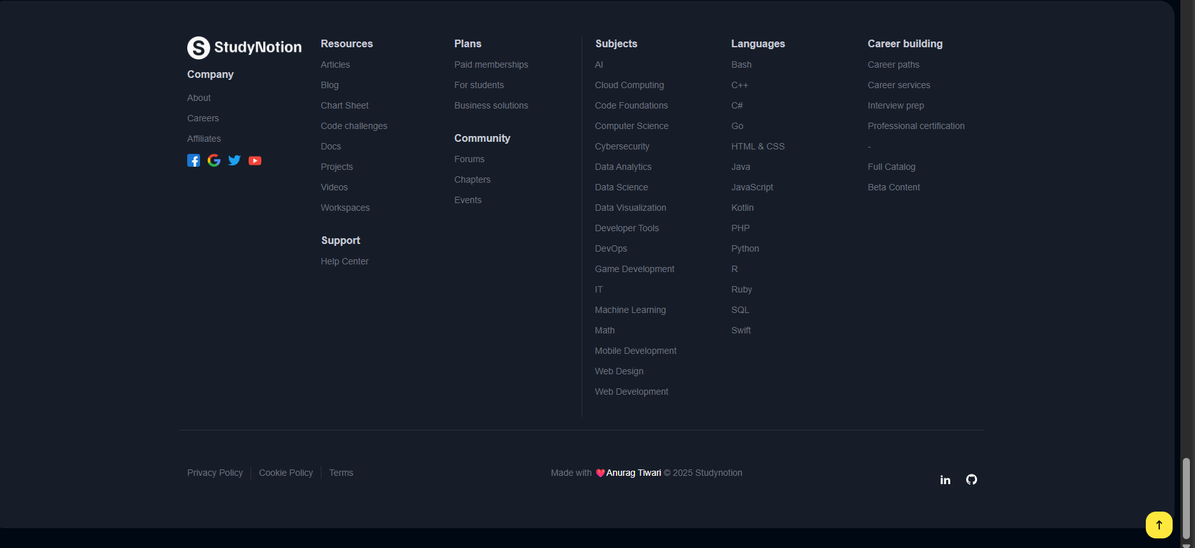
GUI Screenshots

Slide 38
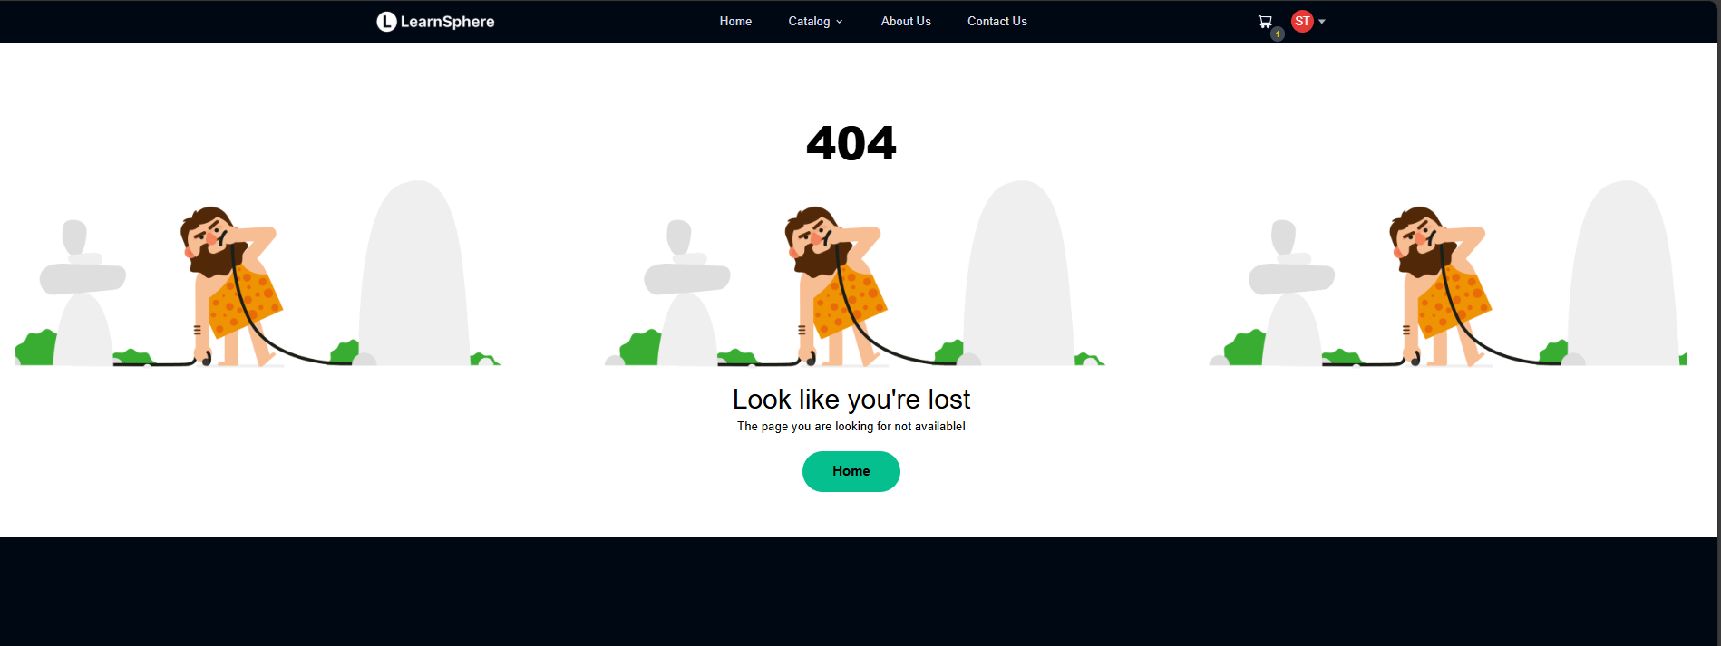
GUI Screenshots

Slide 39
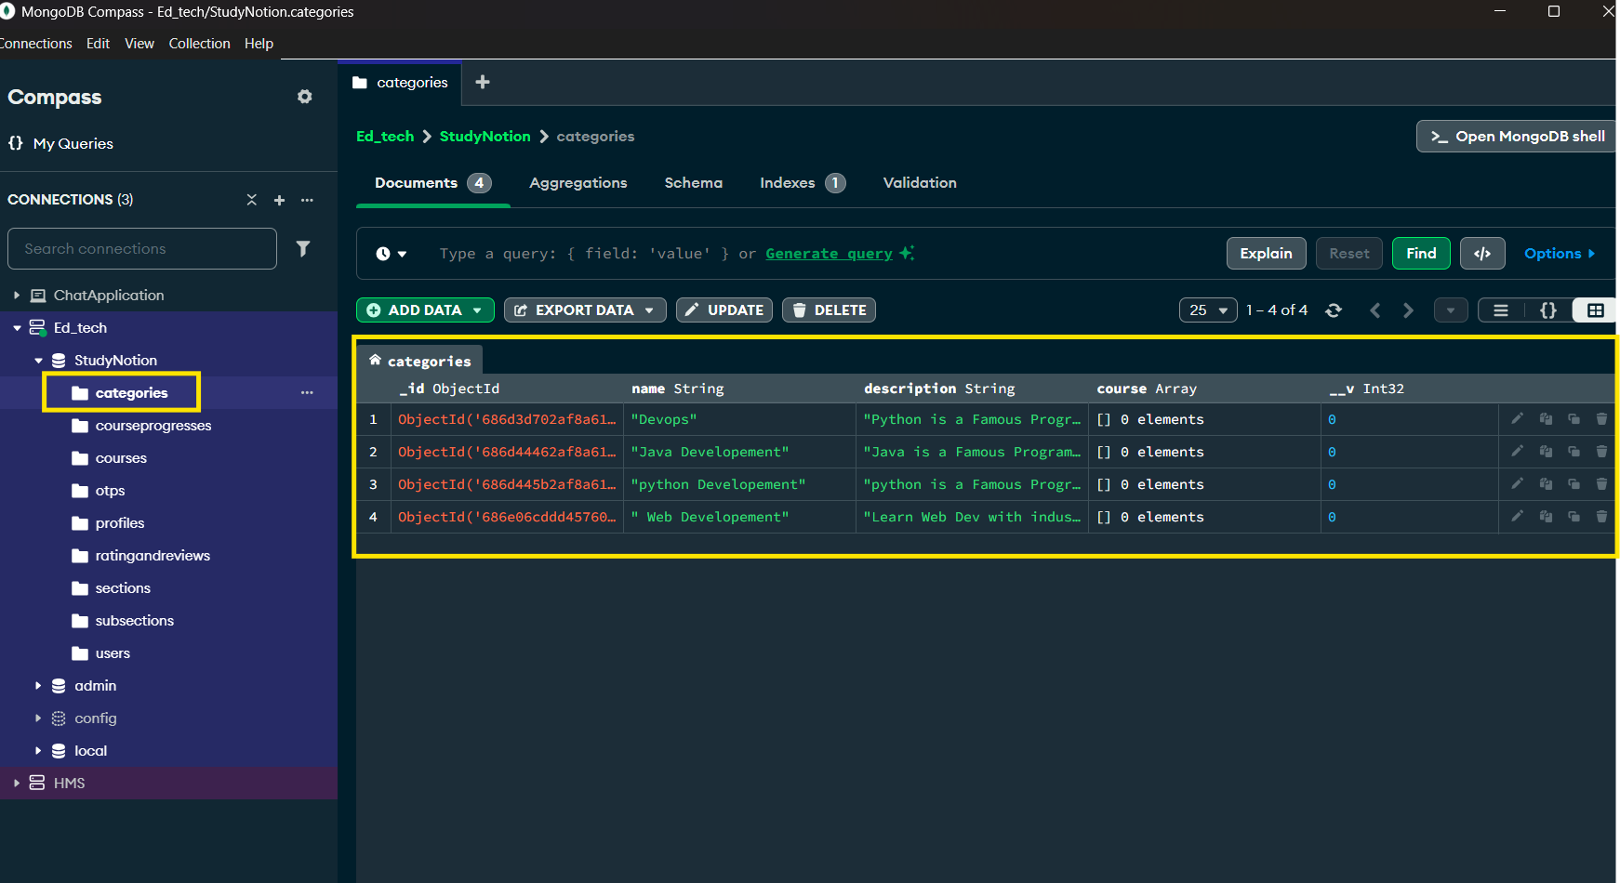
User data inDB

Slide 40
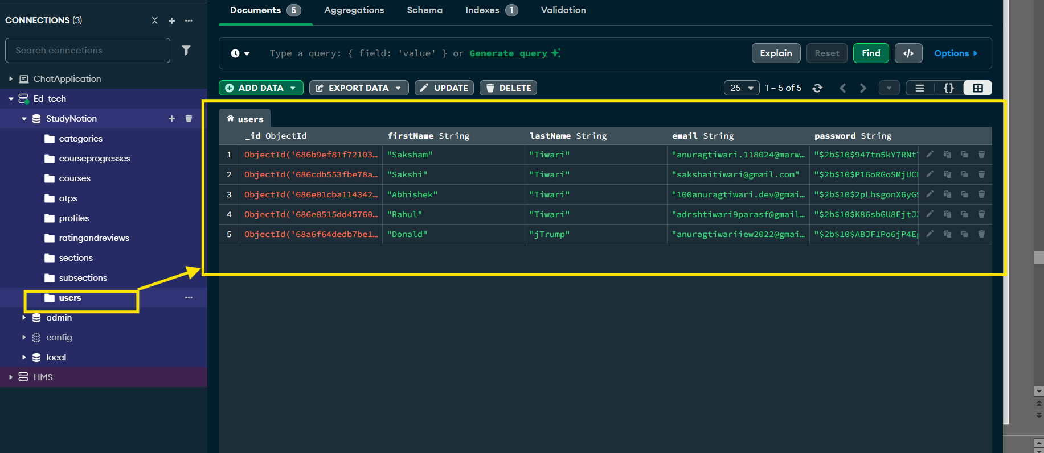
Post Data in DB

Slide 41
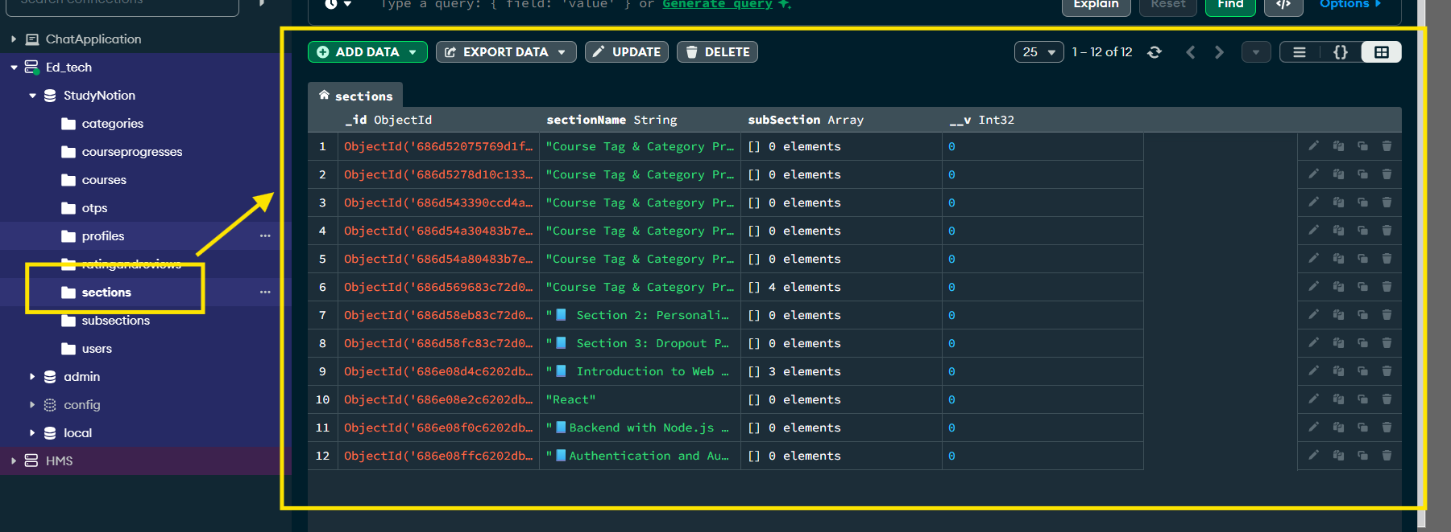
PostLikes Data in Db

Slide 42
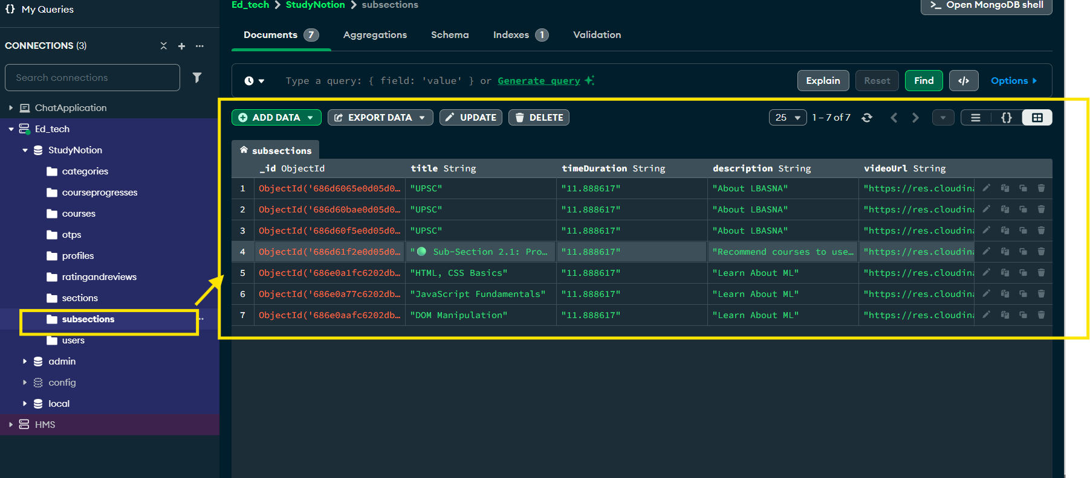
Comments data in Supabase

Slide 43
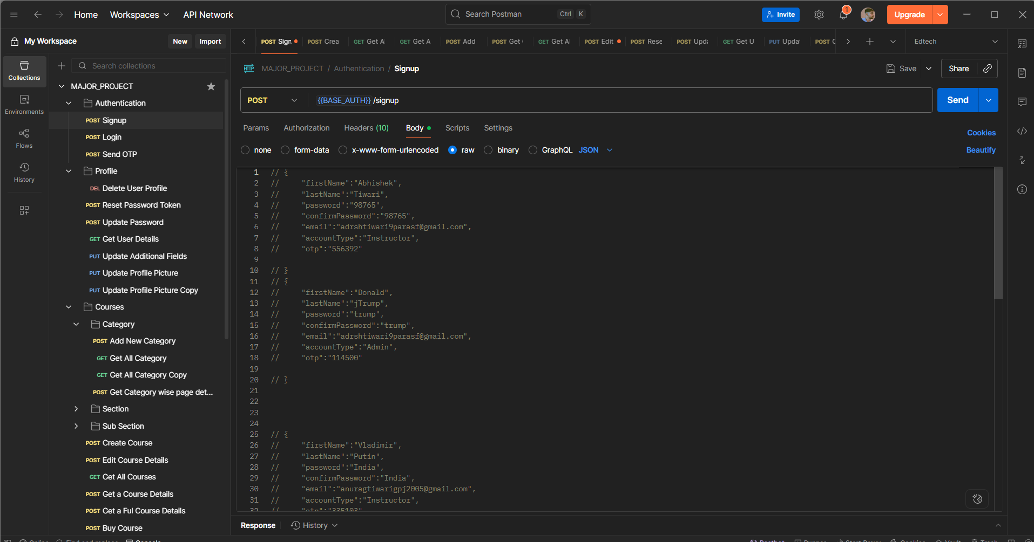
Comments data in POSTMAN

Slide 44
Conclusion
The StudyNotion project successfully demonstrates the development of a modern, full-stack ed-tech learning management system using the MERN stack (MongoDB, Express.js, ReactJS, and Node.js). It integrates essential features such as secure user authentication, customizable profiles, course creation and management, video-based learning content, assignments, payments with Razorpay, and student feedback through ratings and reviews, providing learners and instructors with an engaging and interactive platform. By leveraging MongoDB for scalable data storage, Express.js and Node.js for robust backend services, and ReactJS with Redux for a responsive frontend, the platform ensures seamless performance, secure data handling, and efficient media management through Cloudinary. The use of scalable architecture, reusable components, and modular APIs makes the application adaptable for future enhancements and capable of supporting a growing user base.

Slide 45
References
[1] MongoDB, Inc. (2025). MongoDB Documentation. [Online]. Available: https://www.mongodb.com/docs [2] Express.js Foundation (2025). Express.js Documentation. [Online]. Available: https://expressjs.com [3] Meta Platforms, Inc. (2025). React Official Documentation. [Online]. Available: https://react.dev [4] Node.js Foundation (2025). Node.js Documentation. [Online]. Available: https://nodejs.org/en/docs [5] Razorpay Software Pvt. Ltd. (2025). Razorpay Payment Gateway Documentation. [Online]. Available: https://razorpay.com/docs
[6] Author (2025). Studynotion – MERN Stack EdTech Project (GitHub Repository). [Online]. Available: https://github.com/anuragtiwari3100/Edtech-MERN-Stack-Online-Learning-Platform

Slide 46


